Slide 1
Scikits Iowa Alcohol Distributors - Machine Learning Project
AMIL WALGAMAGE, JAMIE TAN & TAS TUDOR

Slide 2

PROJECT SUMMARY
Proposed Solution
High Level:
Machine Learning Product Recommender for wholesale liquor outlets in Iowa USA.
Successfully Completed:
Built and deployed working machine learning website based on data obtained from Google's machine learning public databases.

Slide 3

THE DATA - IOWA WHOLESALE LIQUOR RETAIL SALES 2012 - 2020
Overview of the Dataset
Challenges
Solutions
Contains every wholesale purchase of liquor in the State of Iowa since 2012.
Very large data set
Data included in free tier for Google Colab
Ideally wanted consumer data
Used Google's BigQuery to query the data
State controls the wholesale distribution.
Images of products not in data
Scraped the images from the State of Iowa's Alcoholic Beverages Division website
Contains the following details:
Finding and using the appropriate Machine Learning Models
Store details and location
The brands purchased
Dates
Invoice numbers
Quantity
Found a popular Machine Learning Model - "Turicreate" (an Apple Open Source library)
Virtual Environment Required

Slide 4















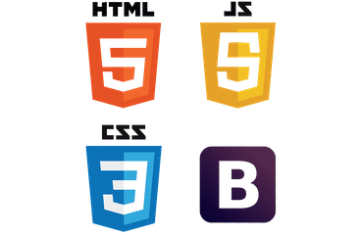



THE TOOLBOX
TOOLS & MACHINE LEARNING
VISUALISATIONS
SOURCES
WEB APP
CHARTING TOOLS
DESIGN & FRONT END

Slide 5



MACHINE LEARNING
The Learning Models
Some stuff about the models

Slide 6
MACHINE LEARNING
TURICREATE
CHARTS HERE

Slide 7
FLASK CALLS
Some stuff about Turicreate

Slide 8
Load
Page
Select New / Existing
Call API
Category
Select Category
Call API
Required
Product
Select Product
THIS IS A ARCHITECHURE LAYOUT

Slide 9
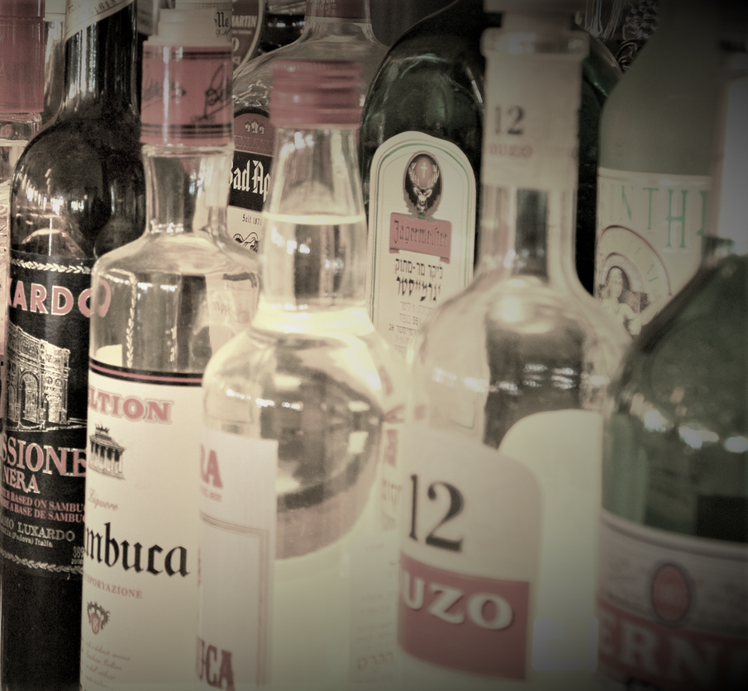
FRONT END
HTML / JAVASCRIPT / BOOTSTRAP / CSS
High Level: Machine Learning Product Recommender for wholesale liquor outlets in Iowa USA.
Completed: Built and deployed working machine learning website based on data obtained from Google's machine learning public databases.

Slide 10


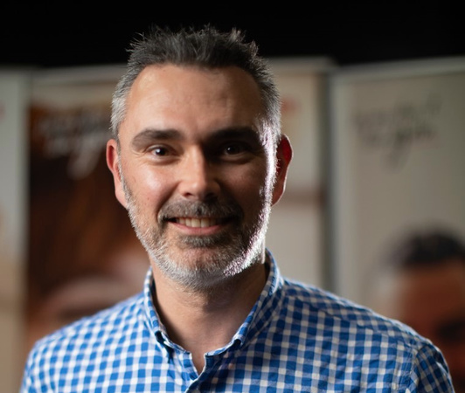
THE TEAM
Amil Walgamage
Jamie Tan
Tas Tudor

Slide 12
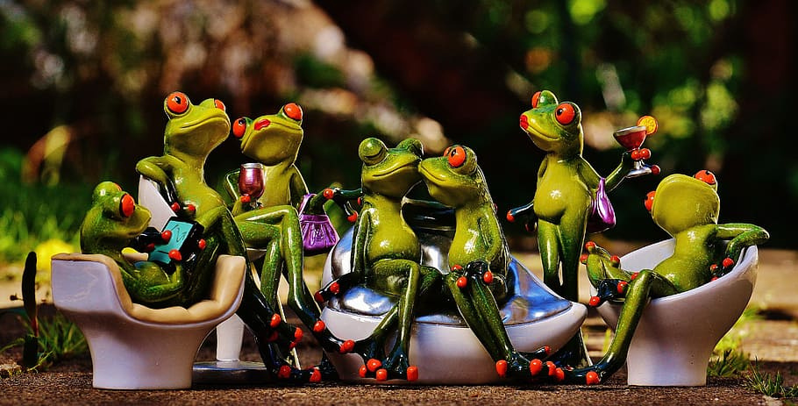
Thank You

